Slide 1

PHOTOBLOG INSTRUCTIONS & TEMPLATE
THE CATALYST

Slide 2
WHAT IS A PHOTOBLOG?
Photoblog is a type of a blog where a single story or idea is communicated primarily via images.
Identify a topic and things, places or people to photograph to capture that topic.
Make 10 – 14 photographs that illustrate your story.
Include descriptions or captions for each photograph. These captions might sometimes be quotes from the people in the photographs.
See examples:
http://abcnews.go.com/International/photos/fight-back-mosul-39880940/image-39882400
https://www.washingtonpost.com/news/worldviews/wp/2016/06/23/8-brexit-voters-reveal-their-thoughts-on-europe/?utm_term=.dd30b01fb5b4
https://www.theguardian.com/cities/gallery/2016/jun/23/south-africa-divided-cities-apartheid-photographed-drone
https://www.wired.com/2015/01/amos-chapple-the-coldest-place-on-earth#slide-4
http://fotoroom.co/water-mustafah-abdulaziz/

Slide 3
TIPS
Watch a video about taking relevant and interesting pictures:
https://www.youtube.com/watch?v=YDzYwr6eh34
HORIZONTAL DIRECTION: it is best to submit photographs in the horizontal or landscape format, as opposed to a vertical format.
PORTRAITS = CLOSE UP: if you are taking a photograph of a person, it is the best to have a close-up of the face, but the person should not necessarily look at the camera.
BACKGROUND = CONTEXT: the background of the image should add to the storyline without distracting. For example, if you are presenting a story of a social enterprise in Kathmandu, it would be the best to take the portrait of the CEO in his professional environment.

Slide 4
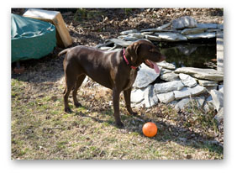
Example of a weak photograph
What makes the photo weak?
Low quality
Busy and distracting background
Not clear what the image primarily shows. Are we talking about a dog breed or a game with pets?
No caption

Slide 5
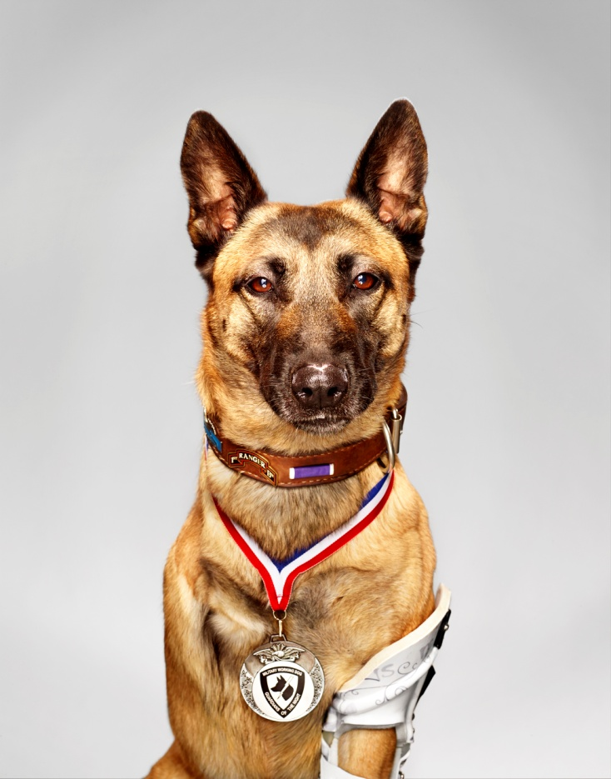
Example of a great portrait
What makes it great?
High quality
The background is not distracting
The medal shows that this dog is special
The mood and character of the dog (yes, even a dog!) is captured
The caption describes what is in the picture
http://proof.nationalgeographic.com/2014/06/26/behind-the-cover-martin-schoeller-and-the-three-legged-dog/
Layka almost gave her life to save a squad of soldiers in Afghanistan. Her owner said “She’s not a lap dog that sits on the sofa, but a disciplined fighting dog.”

Slide 6
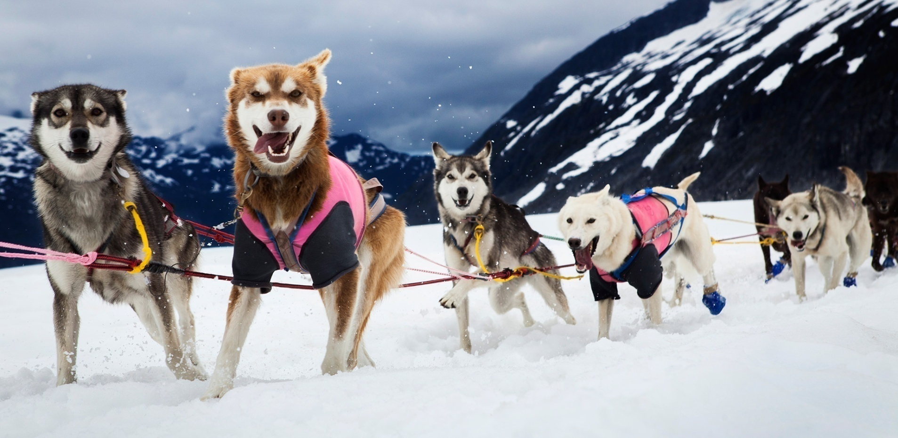
Example of another great photo
On the Herbert Glacier near Juneau, Alaska, the sledge dogs are enjoying their afternoon training.
The background is helping to tell the story and shows the location. Yet, it is not distracting.
The energy of the dogs is captured
The caption describes what is in the picture
http://proof.nationalgeographic.com/2014/09/03/katie-orlinsky-on-mushing-in-the-dog-days-of-summer/

Slide 7
Photoblog requirements
Always ask for permission, if you are taking pictures of people.
If you are taking pictures of children, written parental consent is essential.
Please save in JPEG or JPG format.
We recommend horizontal images of 1920 x 1080 pixels.
Mobile phone pictures are accepted as long as they are of at least 800x600 pixels and of high resolution.
Maximum 700 words for all captions.

Slide 8
THE TEMPLATE
Please select on of the main themes and narrow it down to your specific topic:
Social Innovation in Nepal
Politics in Nepal
Young Nepal
Entrepreneurship
Please insert information, images and captions in the following slides:

Slide 9
Title of the photoblog
NAME OF THE AUTHOR:
NUMBER OF IMAGES:

Slide 10
1. Location: Date: People in the image:
Caption

Slide 11
2. Location: Date: People in the image:
Caption/Description: What is in the picture above?

Slide 12
3. Location: Date: People in the image:
Caption

Slide 13
4. Location: Date: People in the image:
Caption

Slide 14
5. Location: People in the image:
Caption

Slide 15
6. Location: People in the image:
Caption

Slide 16
7. Location: People in the image:
Caption

Slide 17
8. Location: Date: People in the image:
Caption

Slide 18
9. Location: Date: People in the image:
Caption

Slide 19
10. Location: Date: People in the image:
Caption

Slide 20
11. Location: Date: People in the image:
Caption

Slide 21
12. Location: Date: People in the image:
Caption

Slide 22
13. Location: Date: People in the image:
Caption

Slide 23
14. Location: Date: People in the image:
Caption

